Slide 1
Some Interesting Overprints & Flaws of Cyprus
Many of the Flaws are not listed in Gibbons but are identified by the Cyprus Study Circle in there Study Papers – This means that most do not carry dealer premiums at the current time.
SG3 - The 2½ d Value and the flaws that can be found.
SG7 - 1d Red Overprinted HALF-PENNY
SG8 - 1d Red Overprinted HALF-PENNY
SG9 - 1d Red Overprinted HALF-PENNY
SG10 - 1d Red Overprinted 30 PARA
SG24 - The missing 30 Para value Overprint on 1 Piastre
Problems of the Press of Sort
The ½ Piaster Overprints SG23, 25, 26, 27, 28 and 29
Interesting later flaws

Slide 2
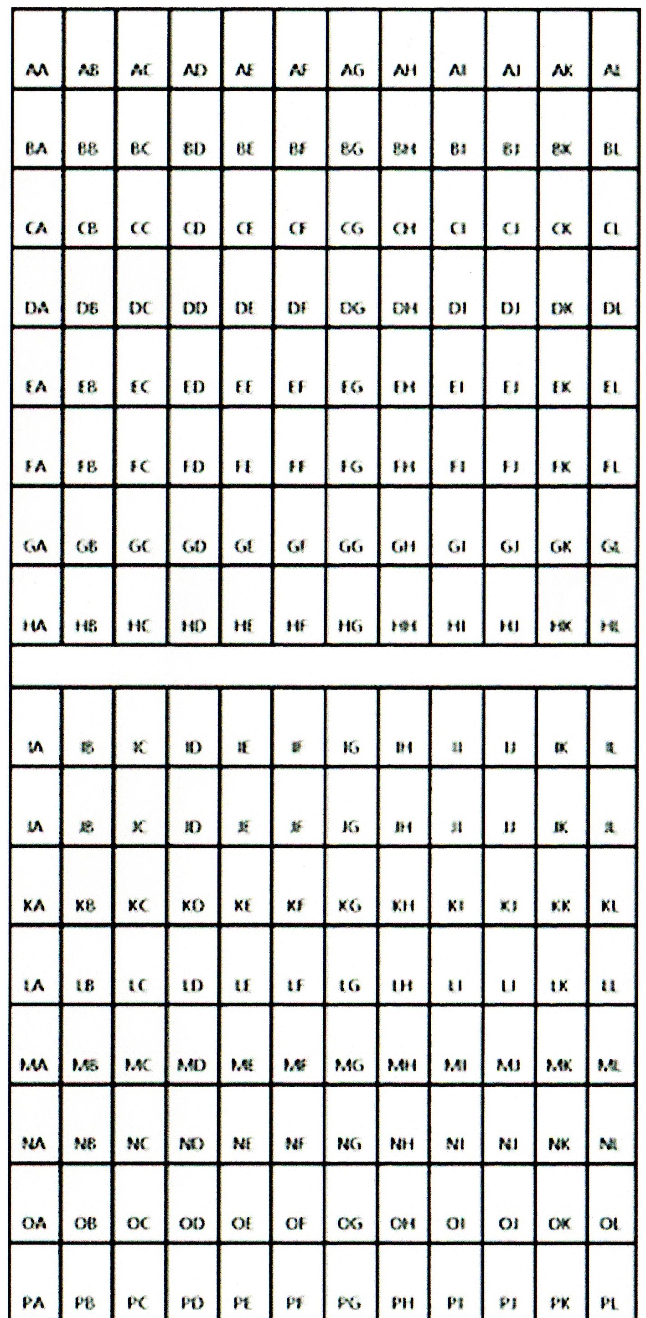
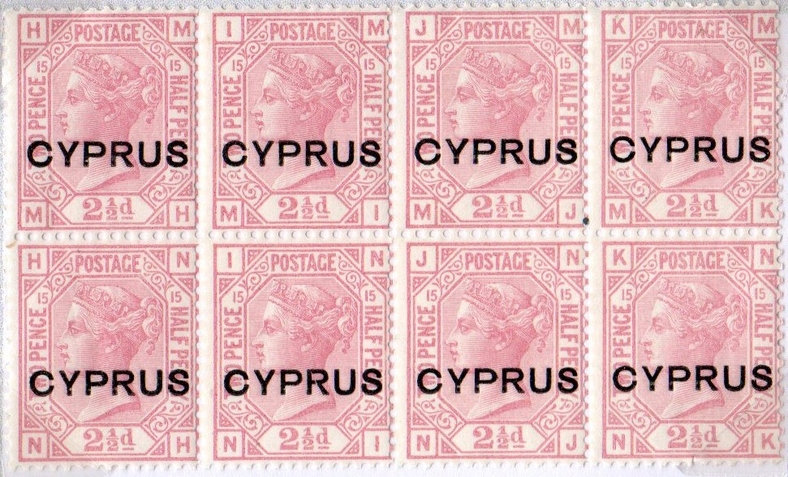
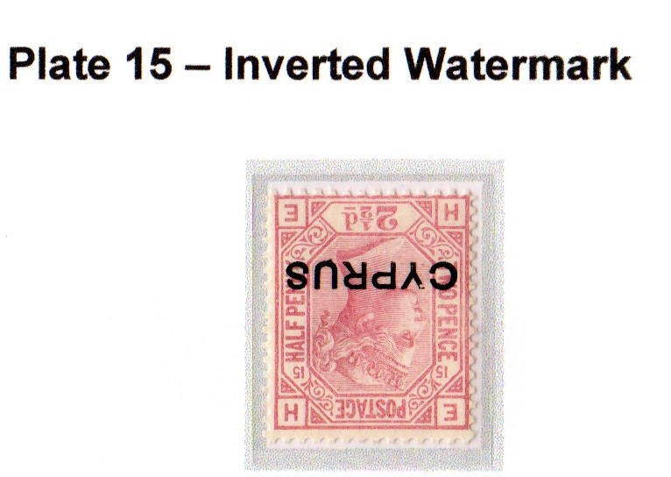
THE GB OVERPRINTS OF CYPRUS – SG3
These overprinted stamps had a large number of flaws in the overprinting.
The overprinting was done in two blocks as shown right. The same flaws appear in each block.
Overprinting was carried out on stamps printed from Plate 14 & 15 only.
The identified flaws appear on stamps from both Plate 14 & 15
One other irregularity known is that at least one sheet from plate 15 has inverted watermarks.
The reference for this study is Study paper No.19 by the Cyprus Study Circle. The full listing of flaws was shown on www.cyprusvictorianstamps.com this website no longer exists and its data is lost. This is now the only remaining record.

Slide 3
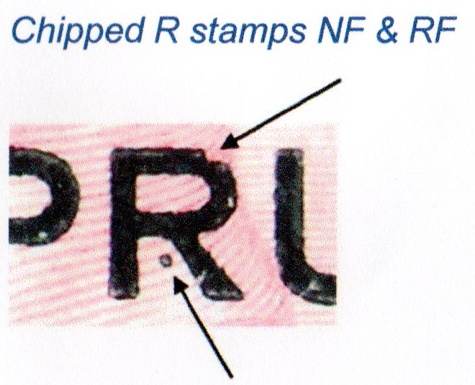
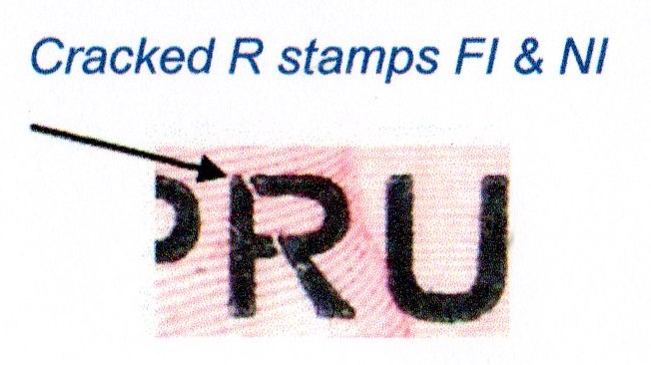
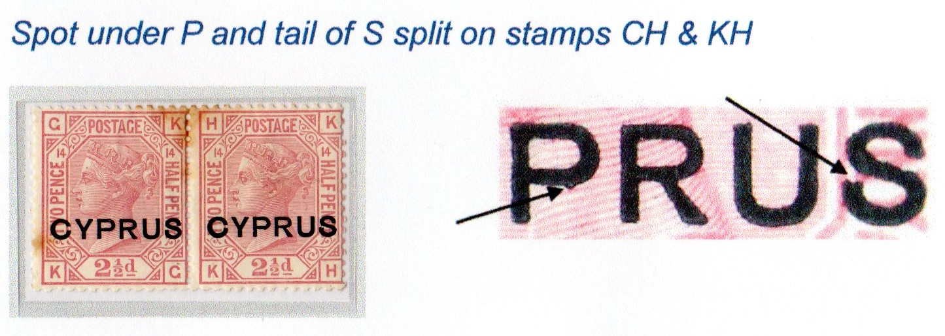
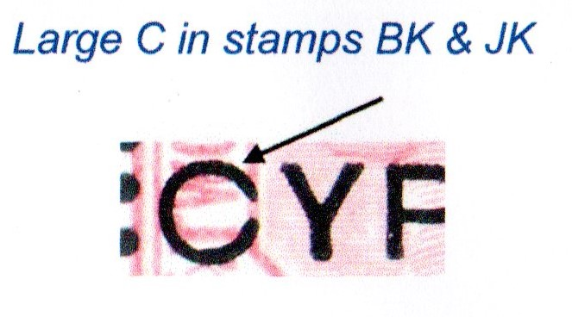
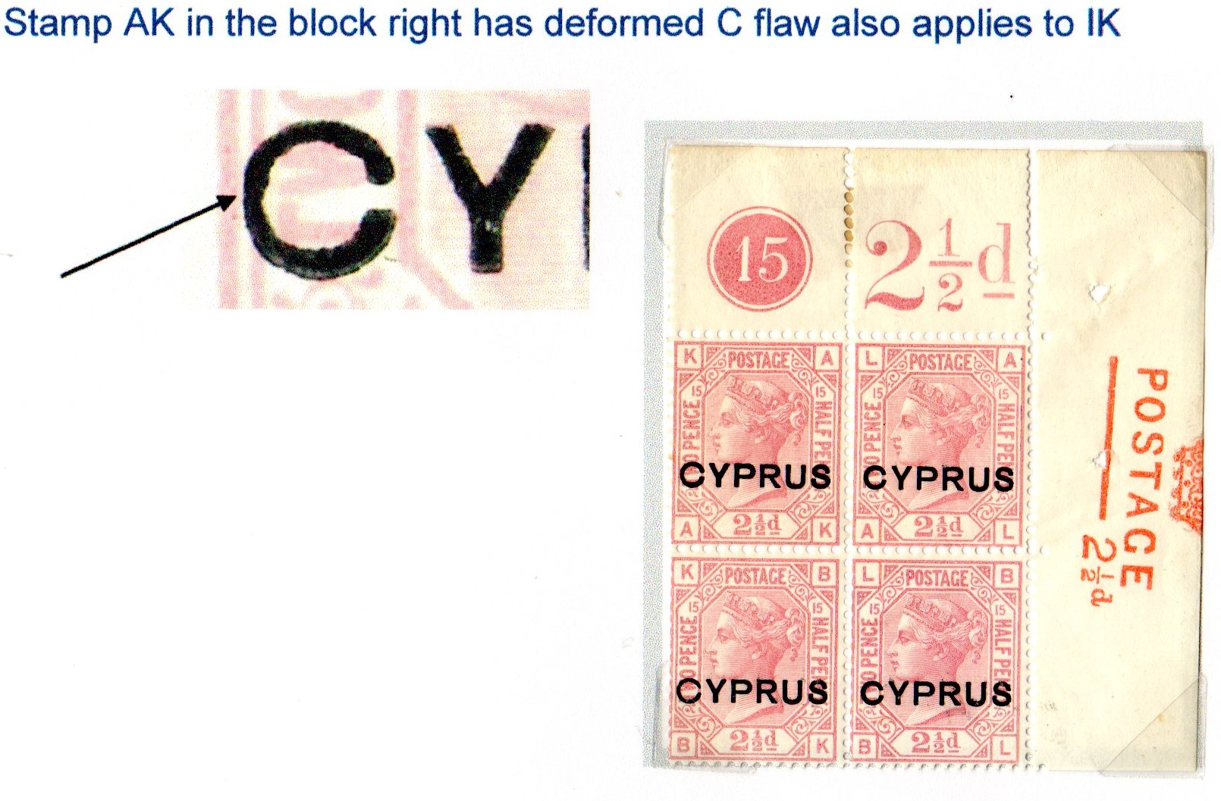
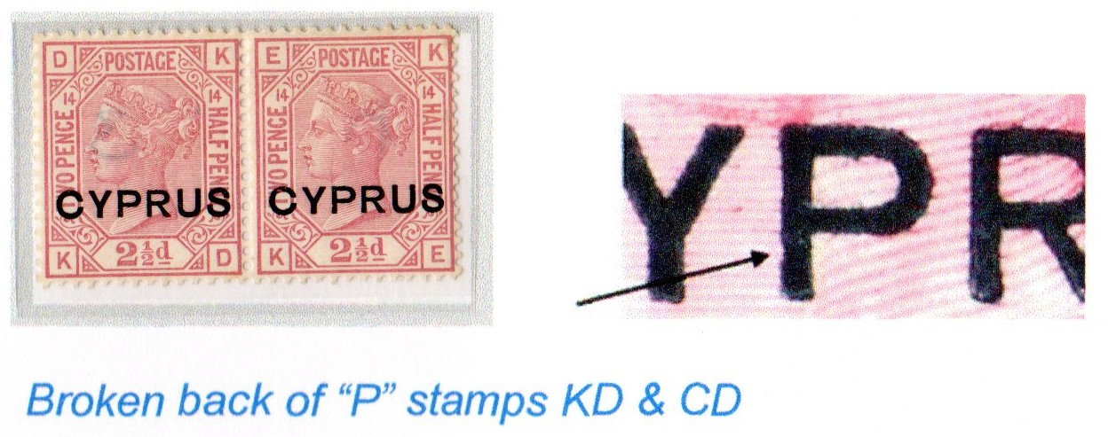
SG3 – Flaws Illustrated

Slide 4
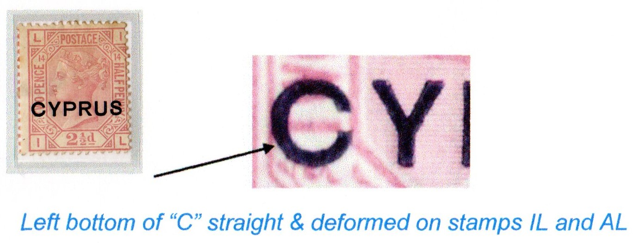
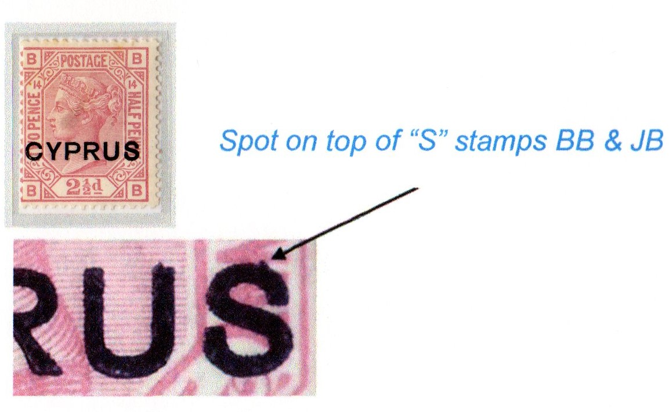
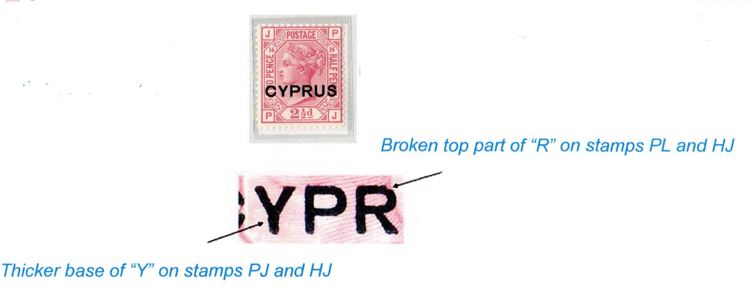
SG3 Illustrated Flaws- Cont

Slide 5
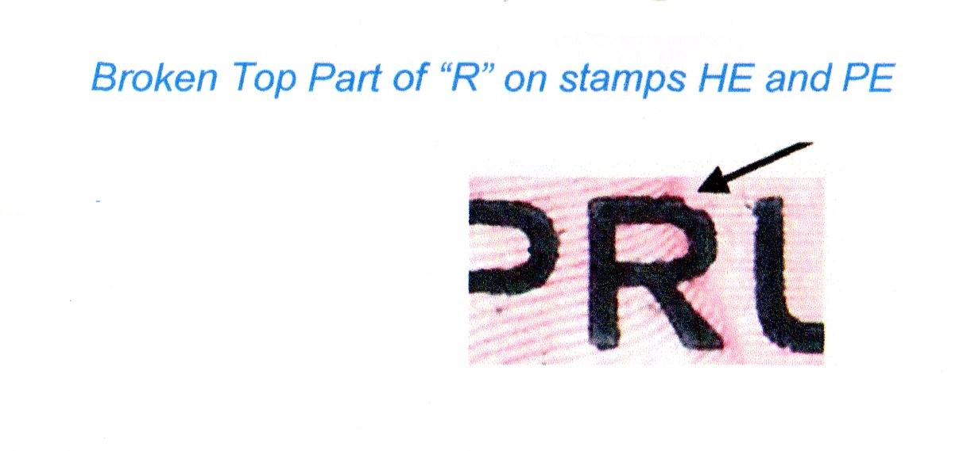
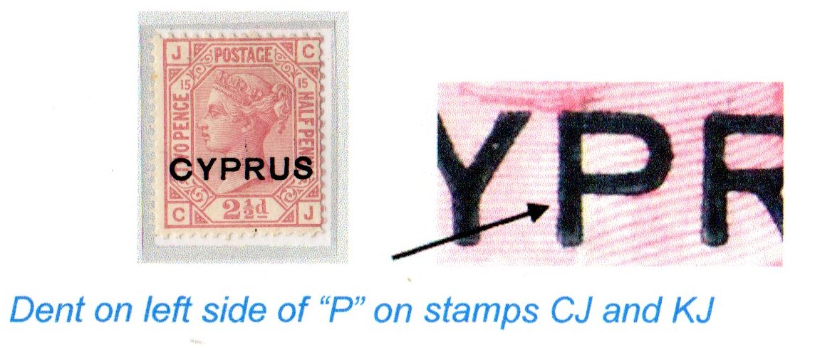
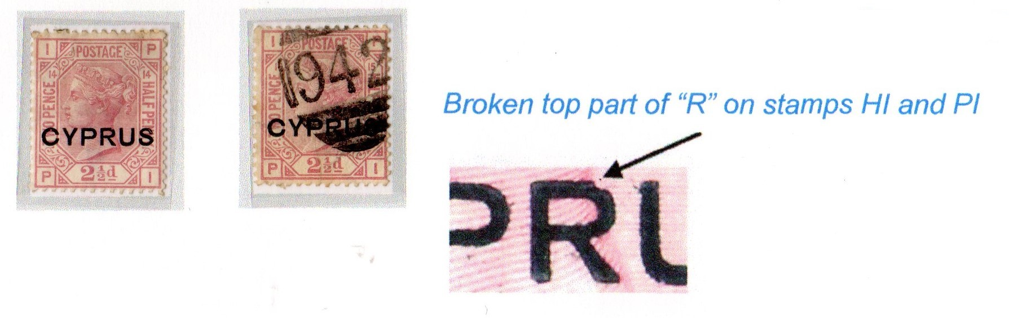
SG3 Illustrated Flaws – Cont.

Slide 6
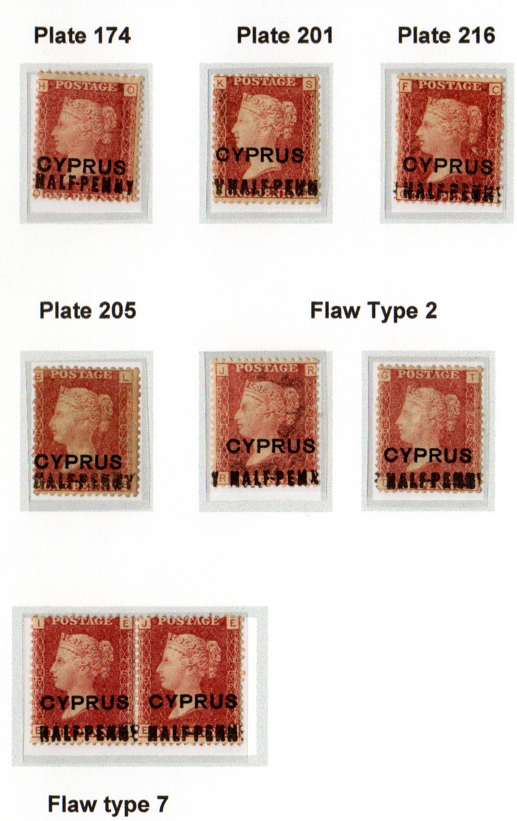
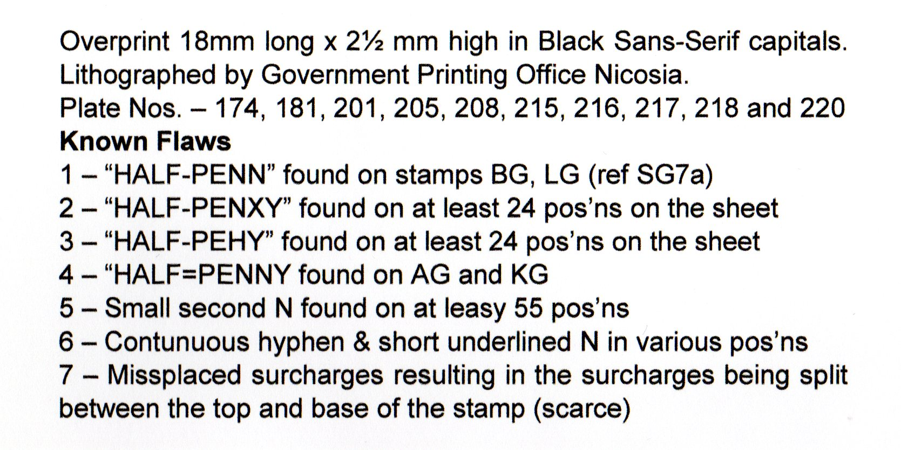
SG7 – 1d Overprinted Half-Penny

Slide 7
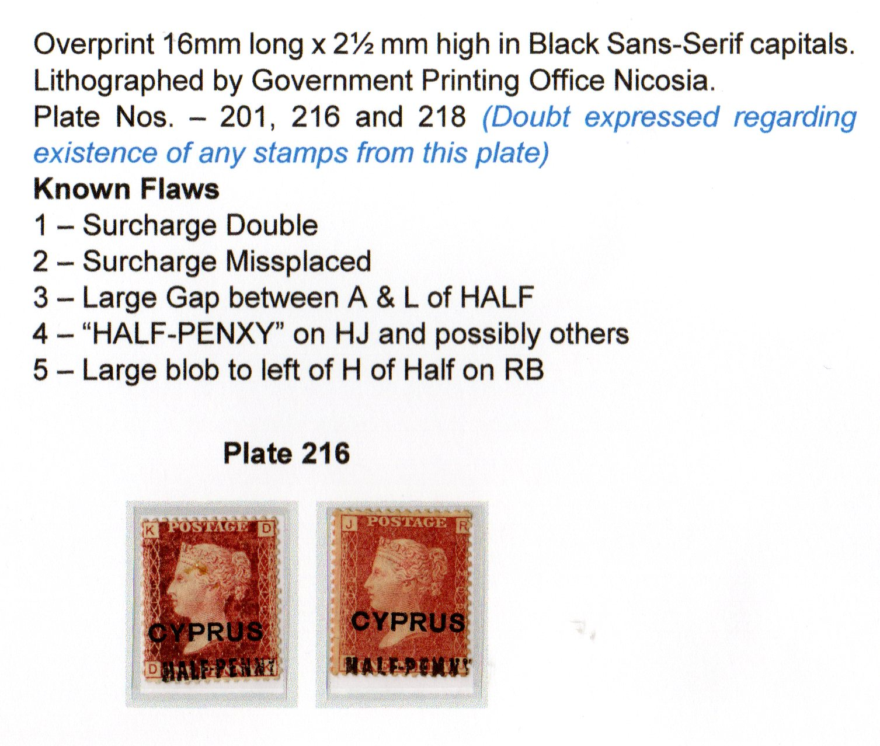
SG8 – 1d Red Overprinted Half-Penny

Slide 8
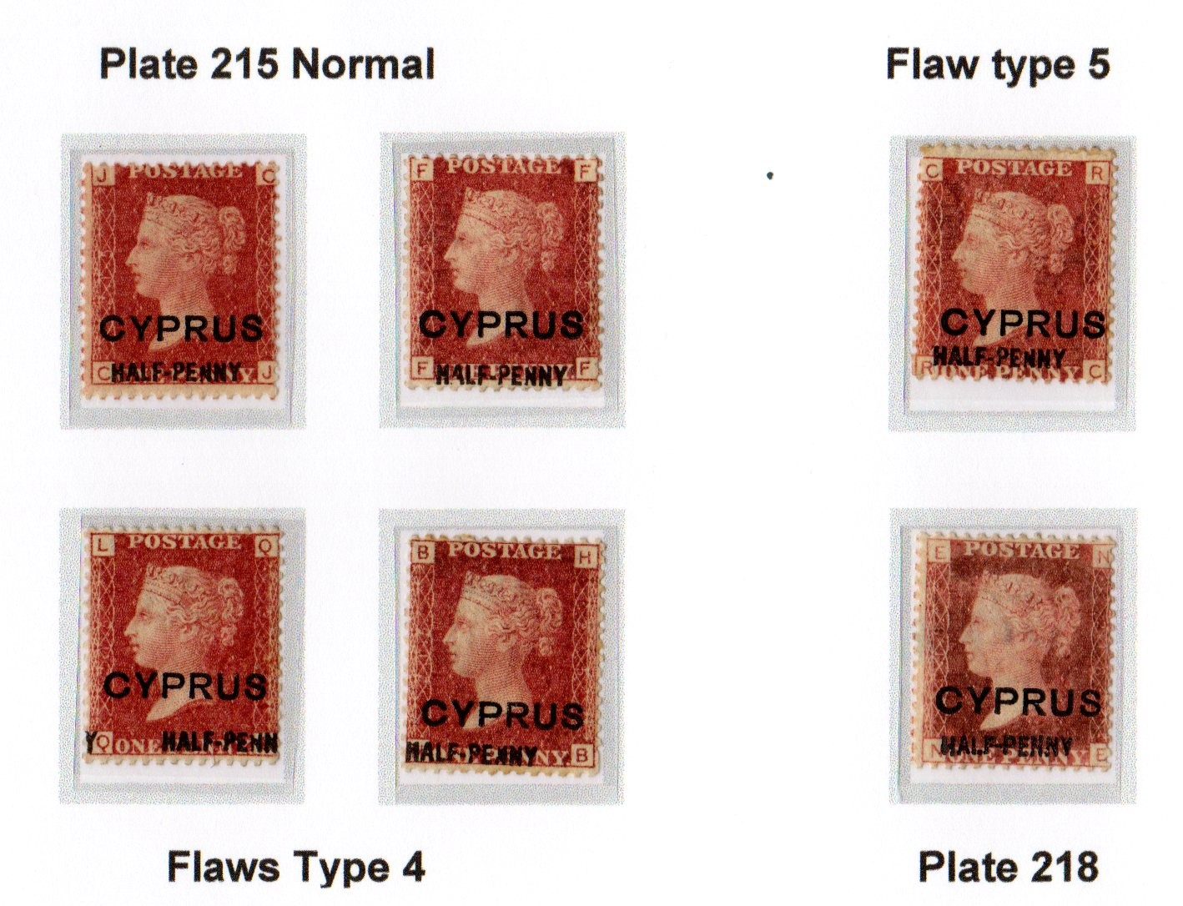
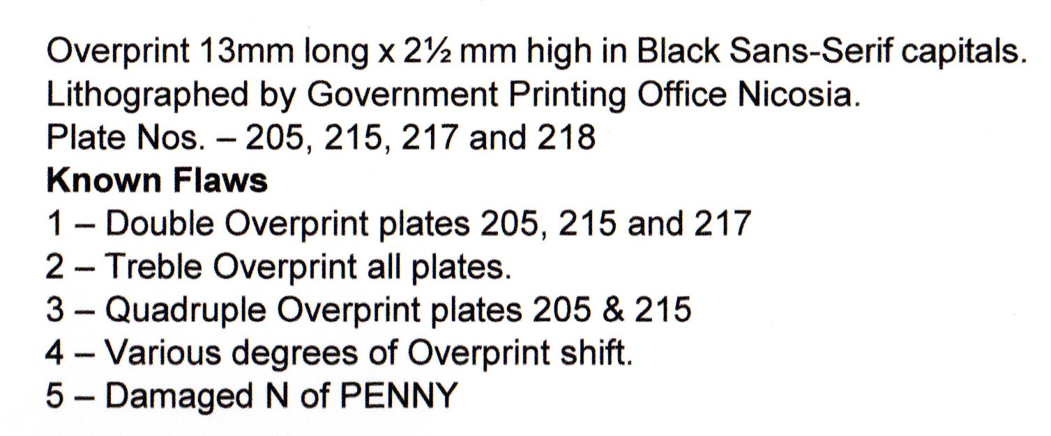
SG9 – 1d Red Overprinted Half-Penny

Slide 9
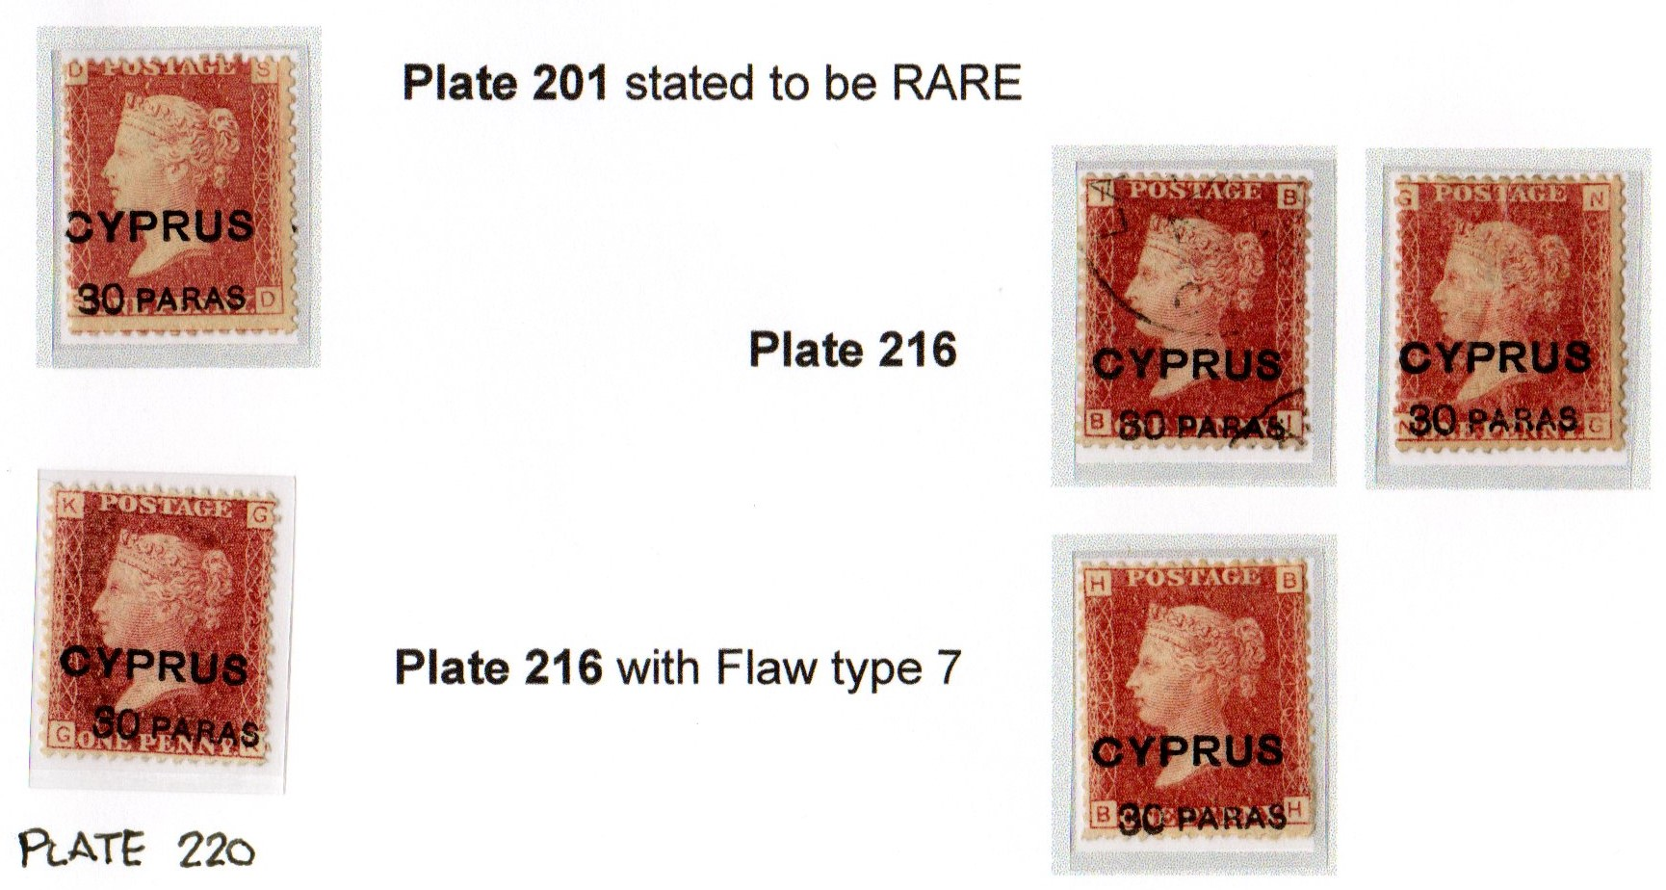
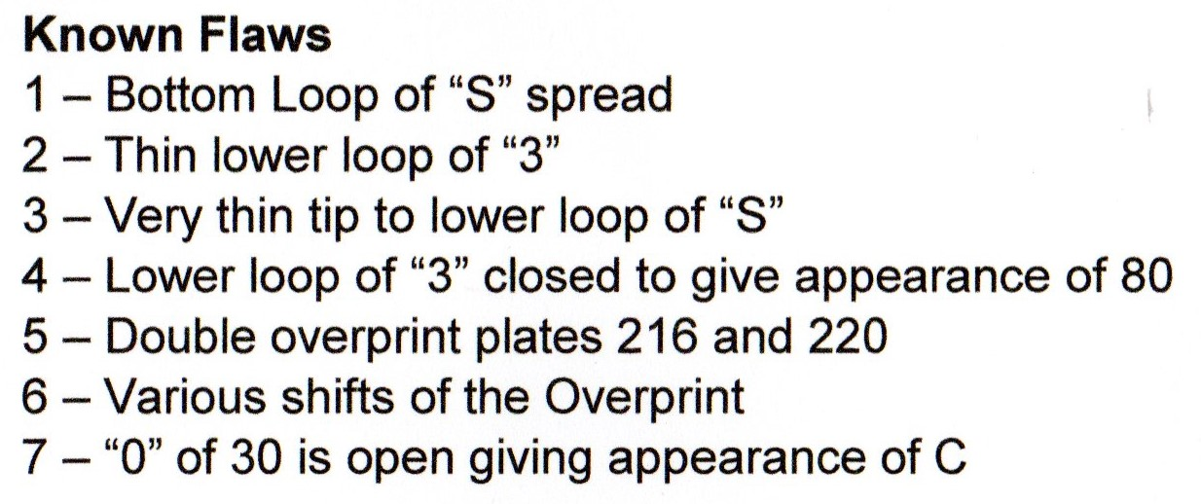
SG10 – 1d Red Overprinted 30 Para
Overprint by Government Office Nicosia Plates 201,216,217 and 220

Slide 10
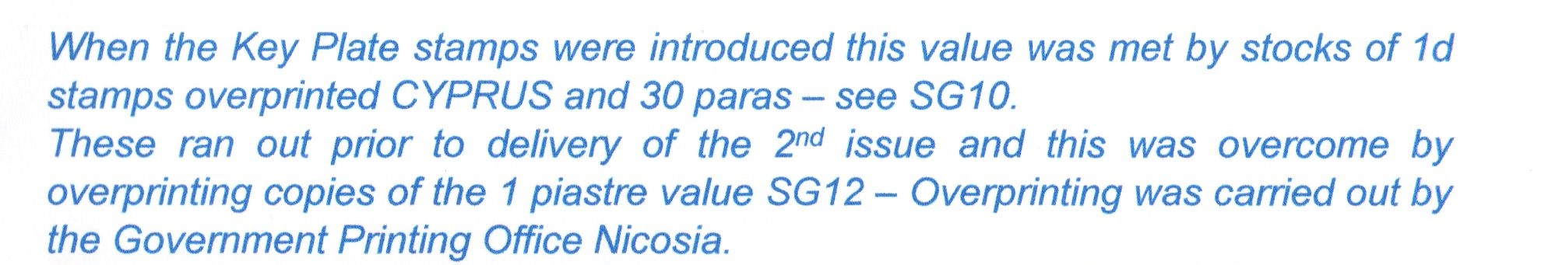
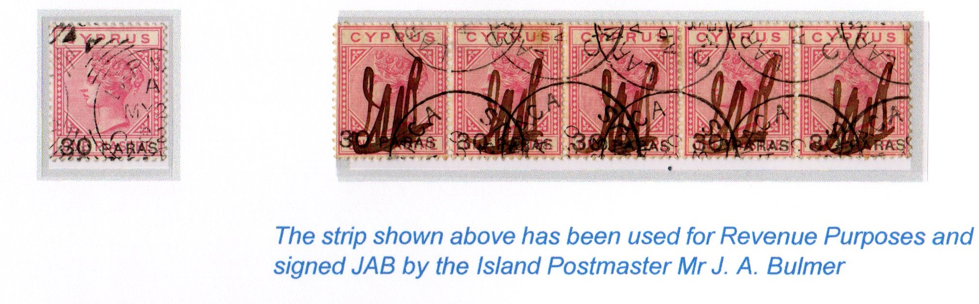
SG24 – 30 Para Overprint on 1 Piaster
The stamp was only in use from 22nd May to 7th June a period of just 17 days

Slide 11
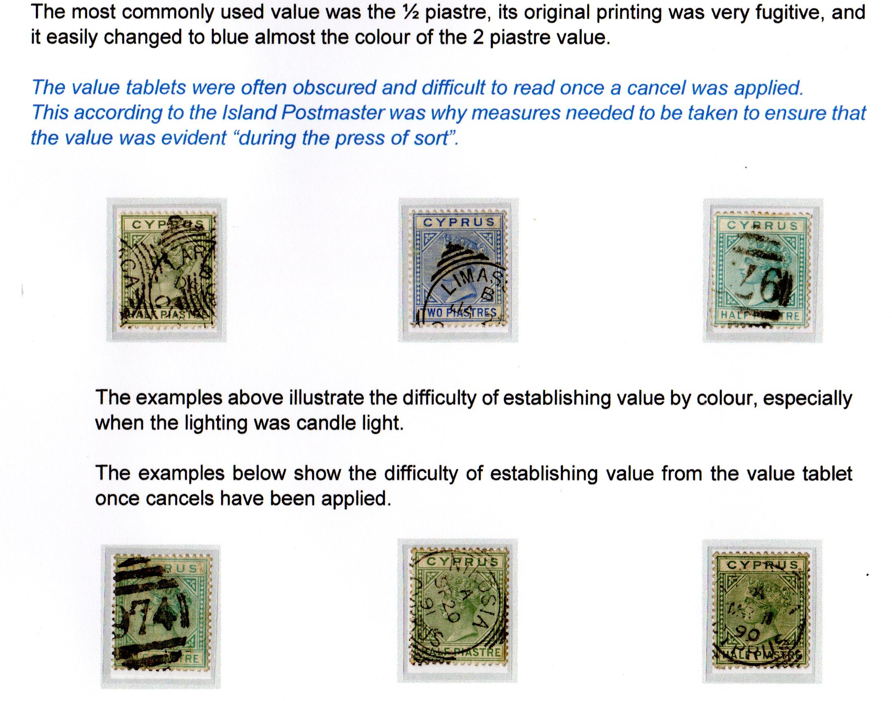
Problems of the Press of Sort

Slide 12
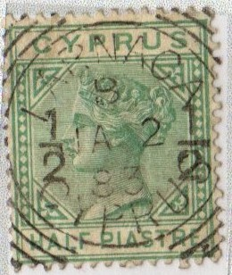
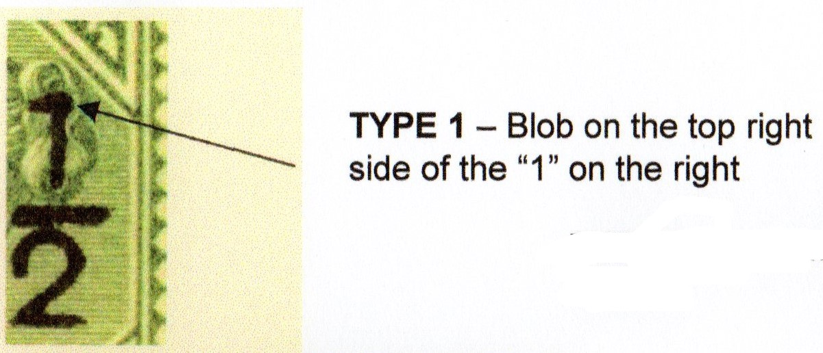
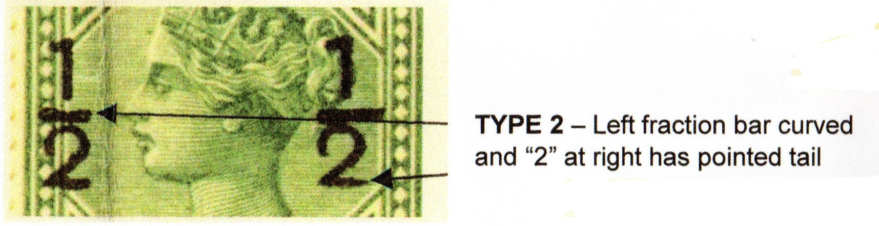
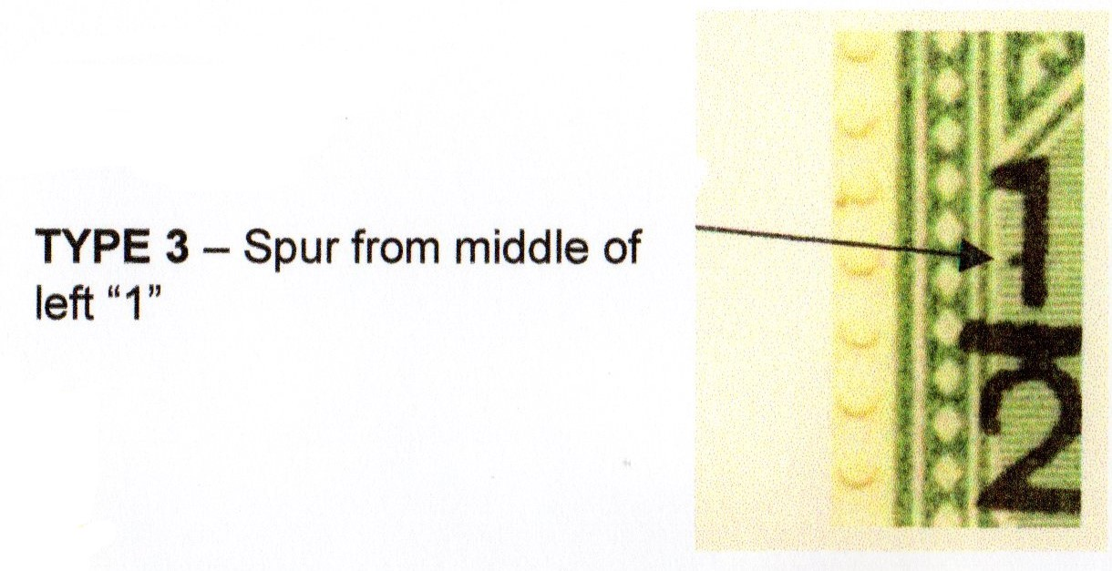
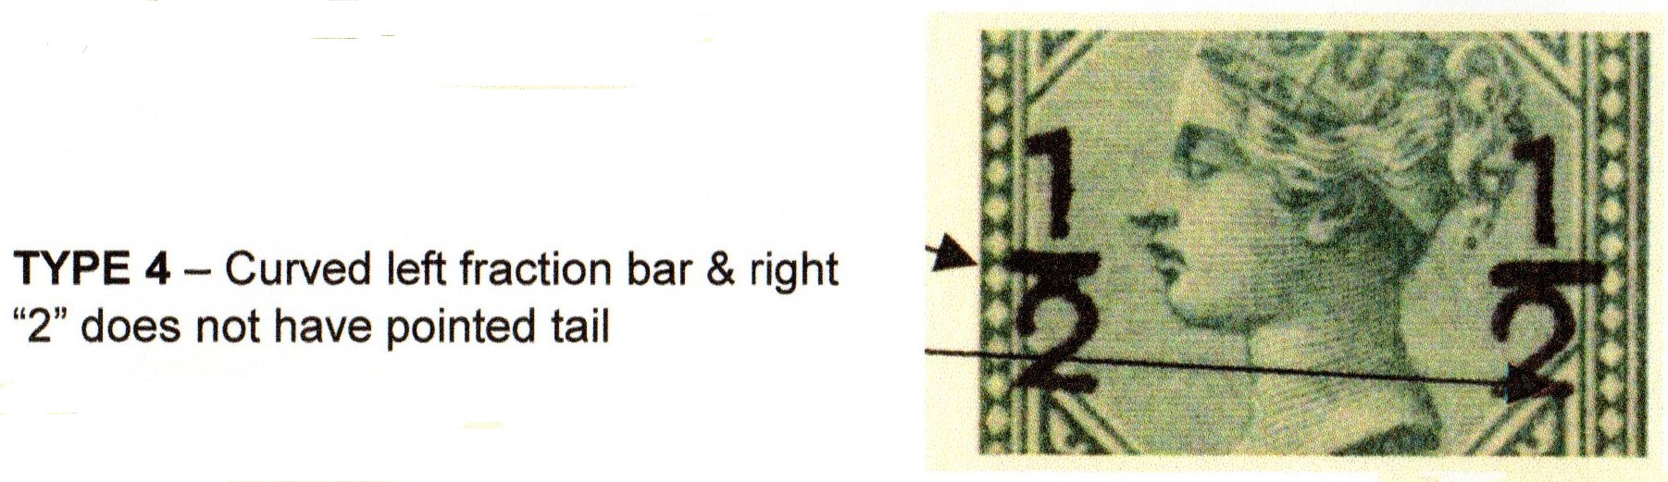
The ½ piastre Overprints SG23 & SG25
Overprinting carried out by Government Printing Office Nicosia on panes of 60 stamps with both CC and CA wmks . Overprinting was in strips of 6 stamps repeated 10 times.
There are significant flaws, some of which are illustrated here

Slide 13
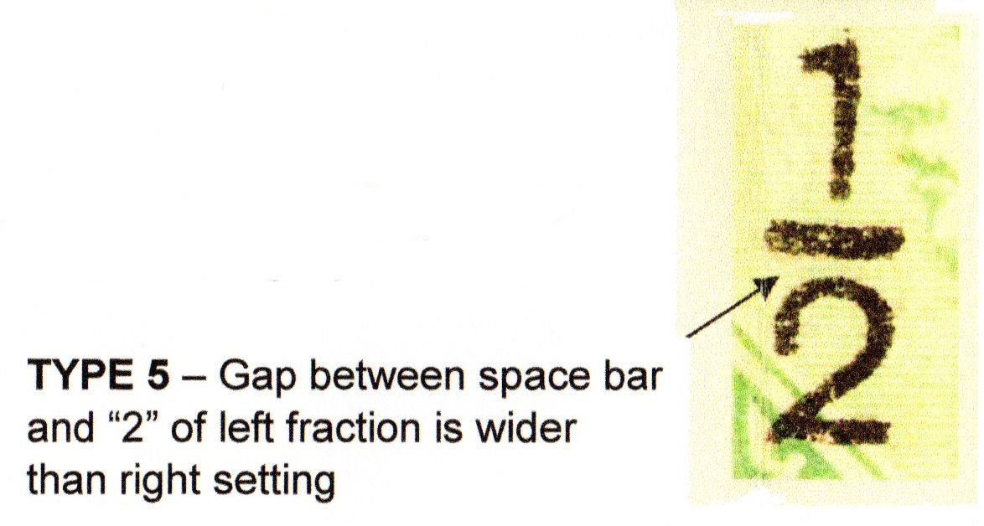
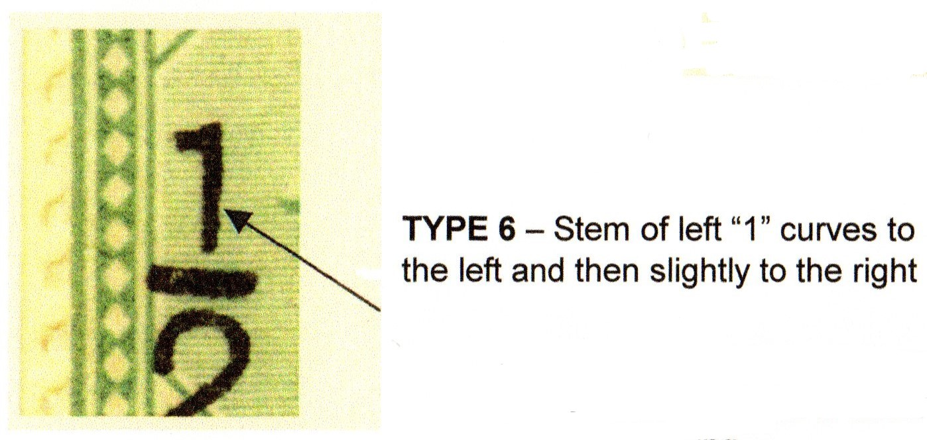
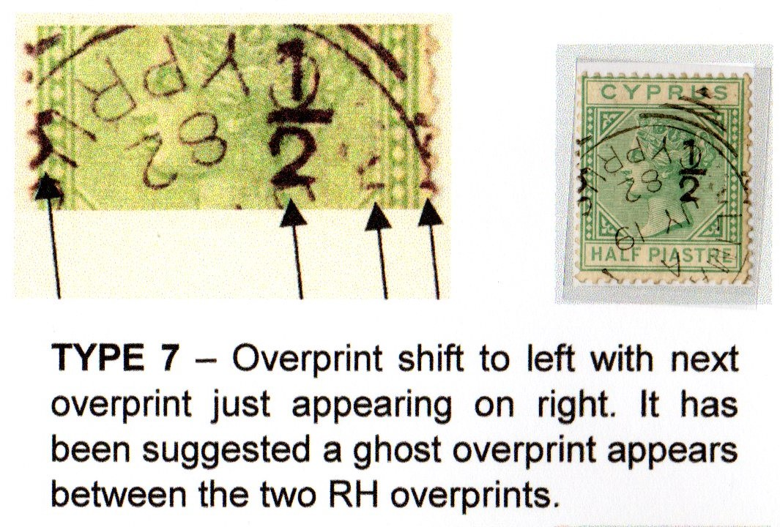
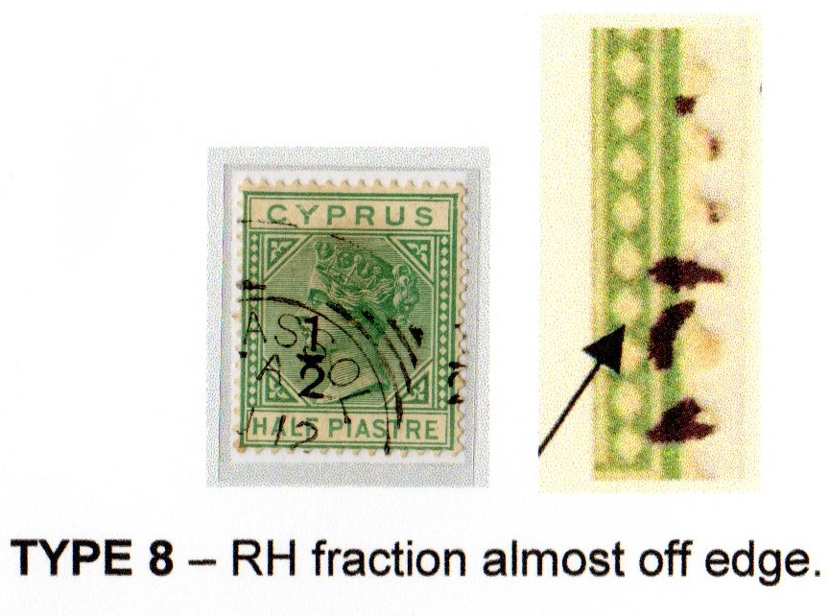
SG23 & 25 Cont.

Slide 14
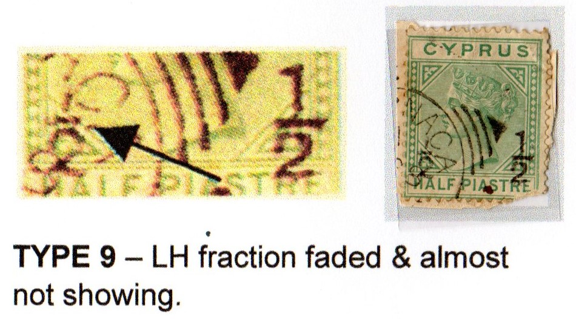
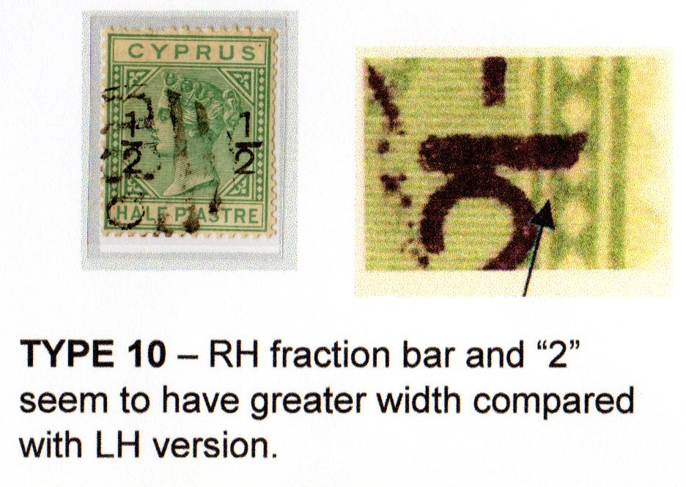
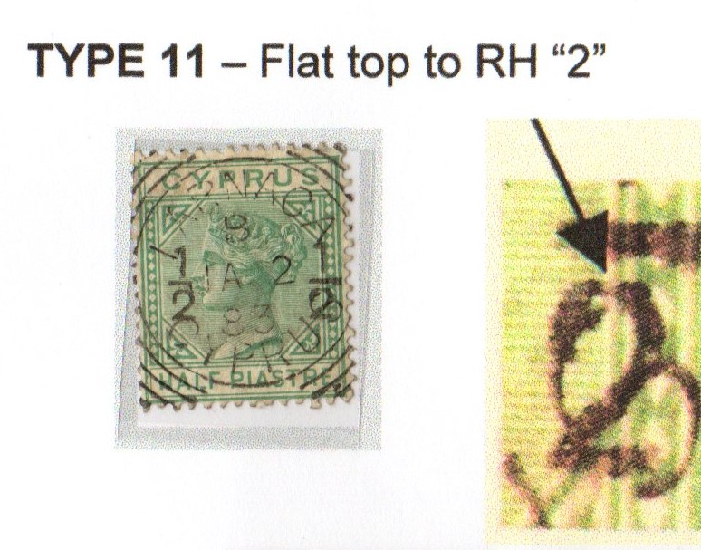
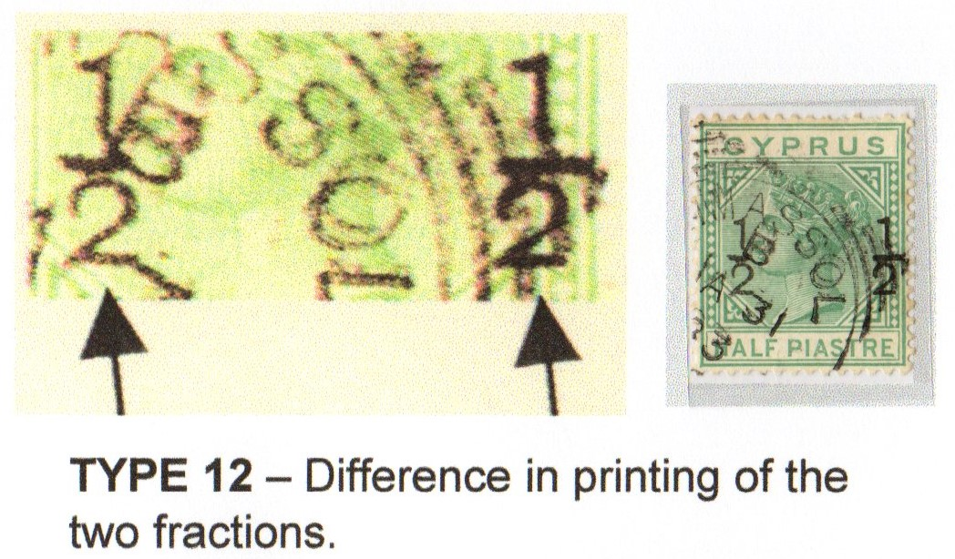
SG23 & 25 cont.

Slide 15
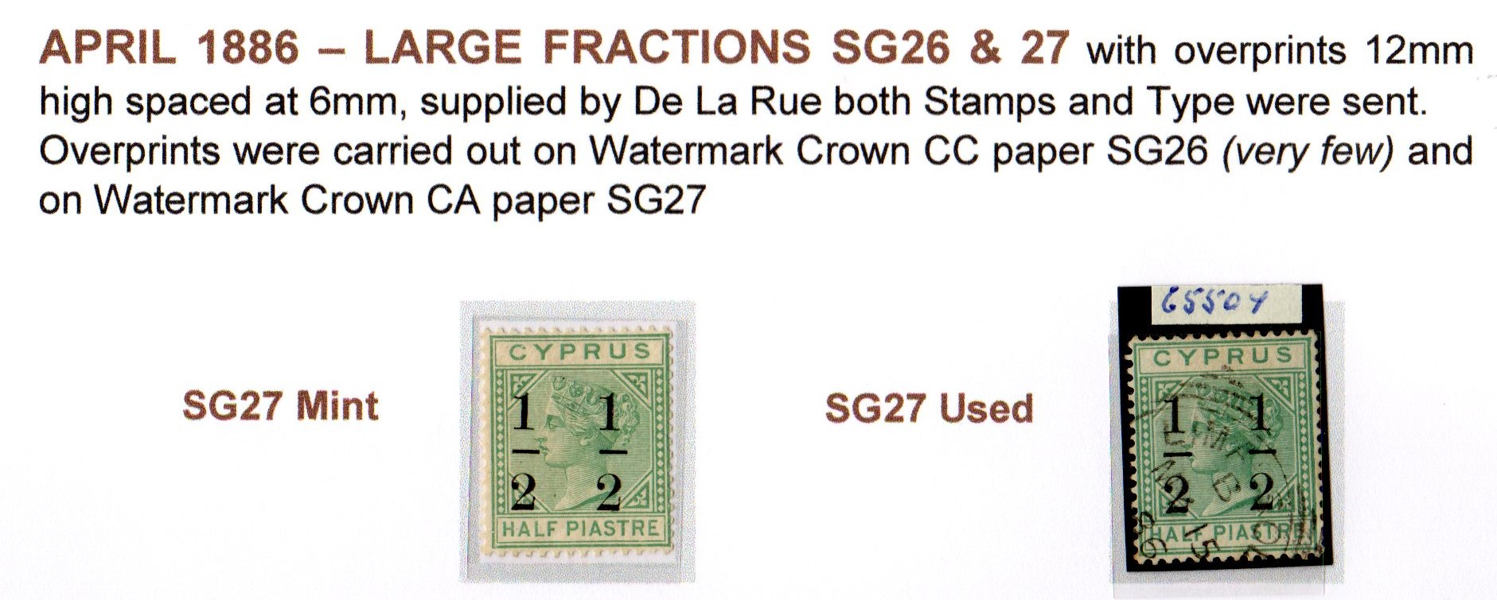
SG26 & 27

Slide 16
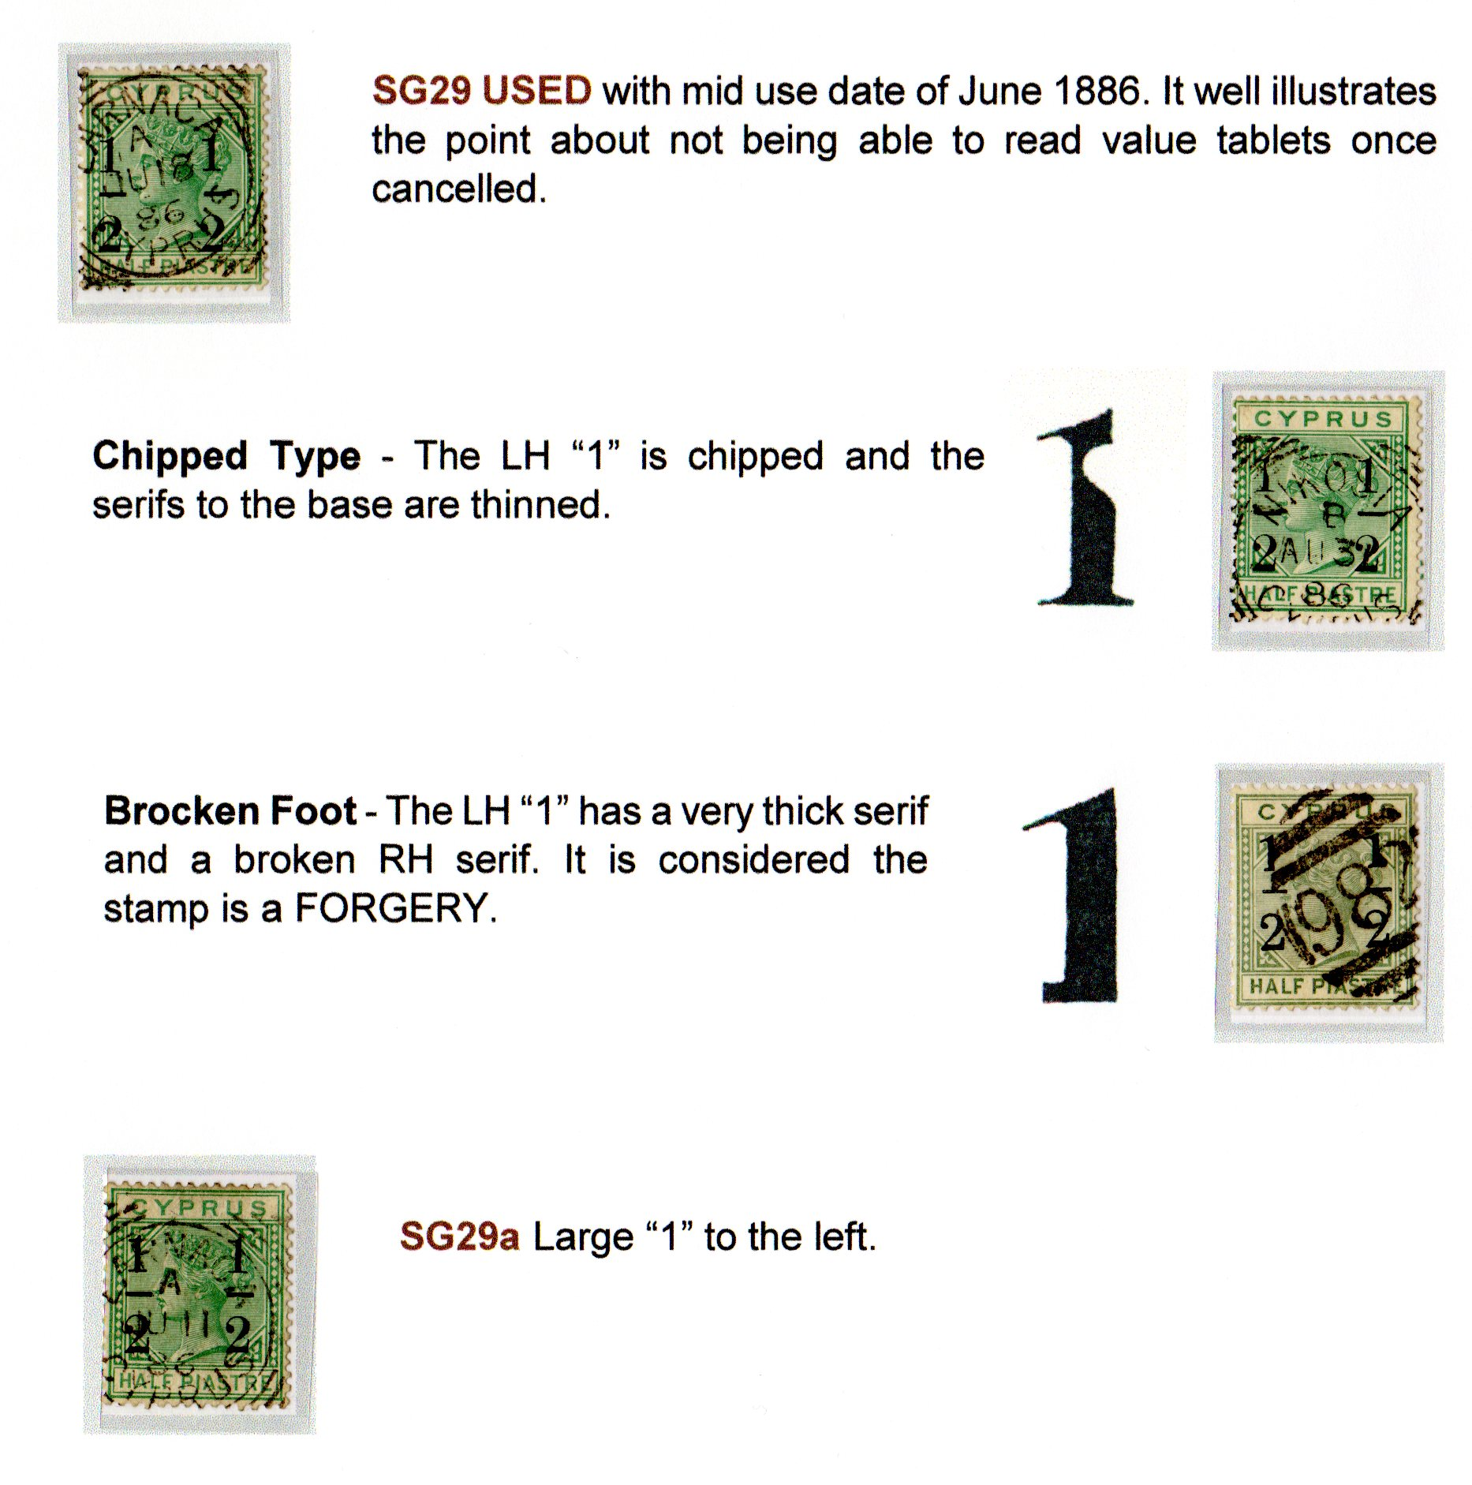
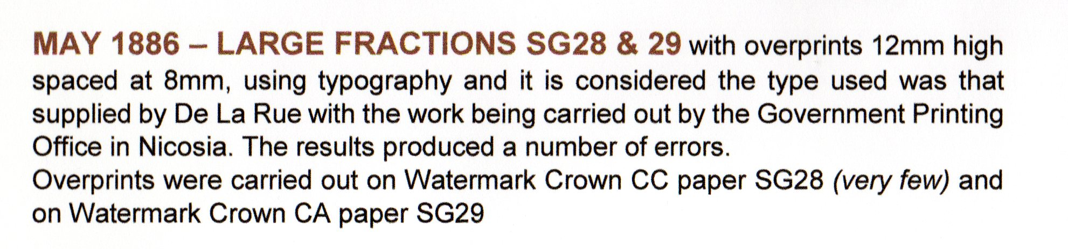
SG28 & SG29

Slide 17
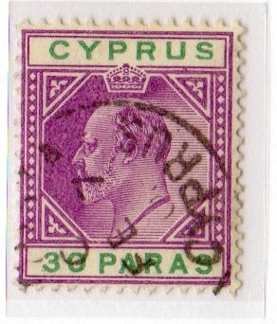
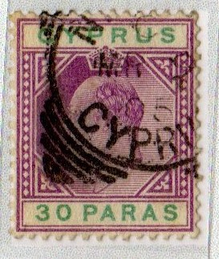
SG63 lower flat to US
Normal stamp above.
Stamp to the right has the underside of the US in CYPRUS flattened.

Slide 18
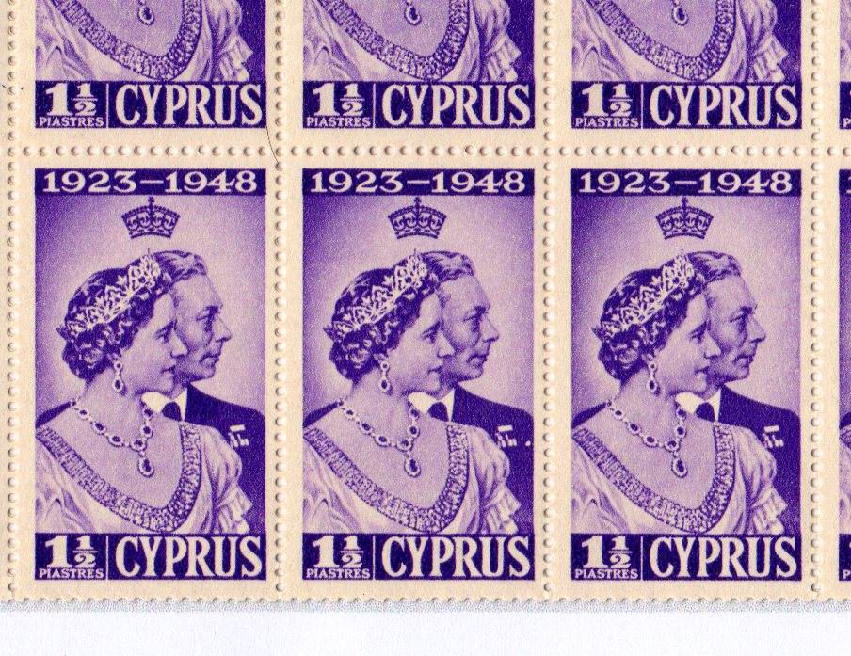
SG166 Extra Medal
The stamp in row 3 column 5 has a dot that appears as an extra medal on the Kings row of medals
END OF SECTION

